Slide 1






2025 SPARK ACADEMY
TRAIN FOR CHANGE, FROM SCIENCE TO PRACTICE
THE SPRINT AI TRAINING FOR AFRICAN MEDICAL
Imaging Knowledge Translation (SPARK)
Academy
IN DEEP LEARNING & MEDICAL IMAGING
Week 1 tutorial (Introduction to python)
FEBRAURY 22 2025

Slide 2


Welcome to SPARK 2025 Exited to start ??!!
https://event.fourwaves.com/spark

Slide 3
Week 1 Introduction to Python
https://event.fourwaves.com/spark

Slide 4
What you are going to learn in SPARK
Data visualization in python
Medical data preprocessing and manipulation
Week 1, 2, 3
Week 4
week 5
week 6
week 7, 8 ,9, 10
Python programming
Introduction to machine learning
Deep learning and medical data segmentation
https://event.fourwaves.com/spark

Slide 5
What you are going to learn in SPARK
Data visualization in python
Medical data preprocessing and manipulation
Week 1, 2, 3
Week 4
week 5
week 6
week 7, 8 ,9, 10
Python programming
Introduction to machine learning
Deep learning and medical data segmentation
https://event.fourwaves.com/spark

Slide 6
What you are going to learn in SPARK
Data visualization in python
Medical data preprocessing and manipulation
Week 1, 2, 3
Week 4
week 5
week 6
week 7, 8 ,9, 10
Python programming
Introduction to machine learning
Deep learning and medical data segmentation
https://event.fourwaves.com/spark

Slide 7
What you are going to learn in SPARK
Data visualization in python
Medical data preprocessing and manipulation
Week 1, 2, 3
Week 4
week 5
week 6
week 7, 8 ,9, 10
Python programming
Introduction to machine learning
Deep learning and medical data segmentation
https://event.fourwaves.com/spark

Slide 8
What you are going to learn in SPARK
Data visualization in python
Medical data preprocessing and manipulation
Week 1, 2, 3
Week 4
week 5
week 6
week 7, 8 ,9, 10
Python programming
Introduction to machine learning
Deep learning and medical data segmentation
https://event.fourwaves.com/spark

Slide 9
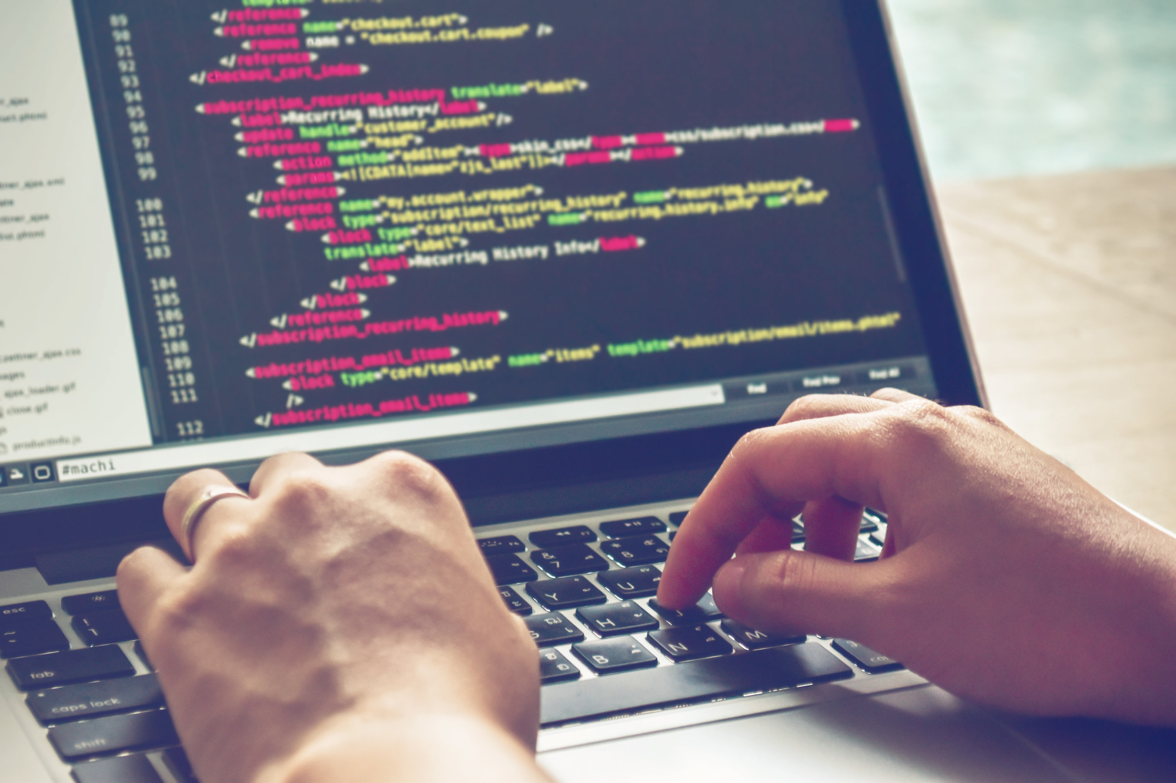
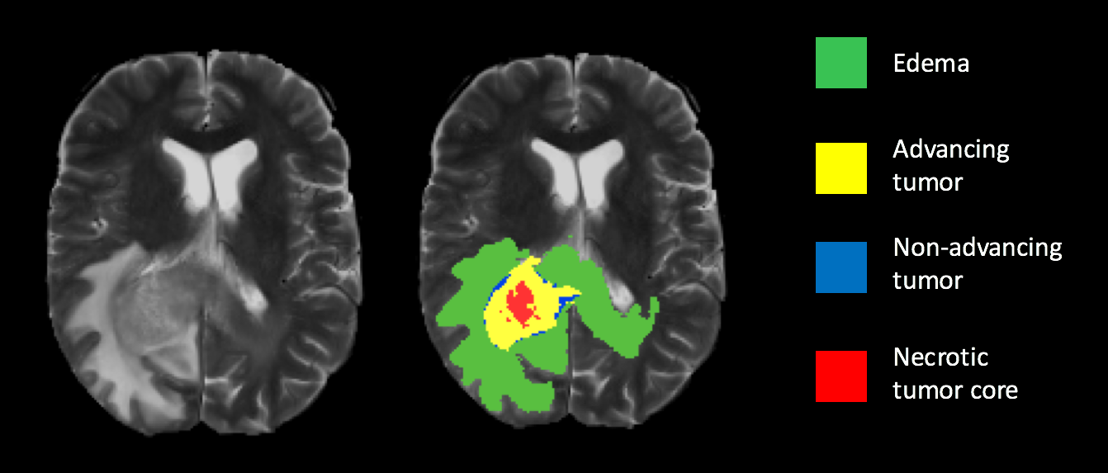
The end goal of SPARK
https://medium.com/@lfoster49203/brain-tumor-segmentation-with-u-net-in-python-a-deep-learning-approach-44758e0812dd

Slide 10
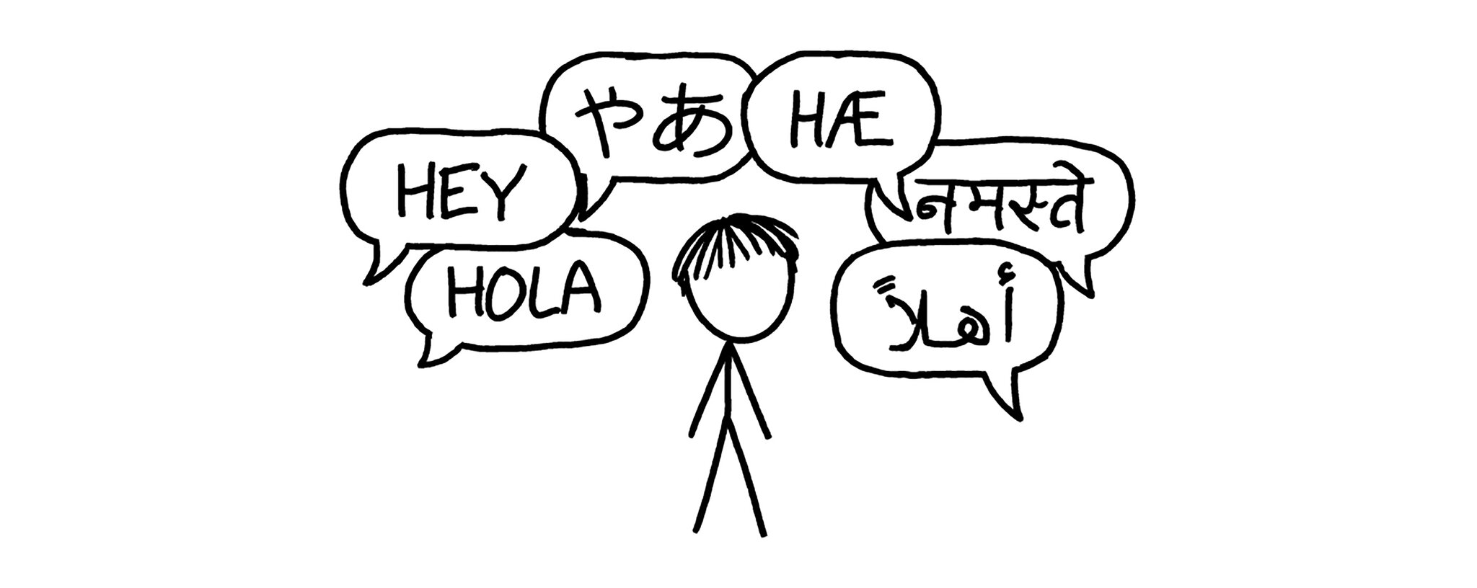
What is a programming language ?
What if we want to communicate with a computer to do a specific task ?!
We use natural language like English and French to communicate our ideas and thoughts as humans
https://event.fourwaves.com/spark

Slide 11
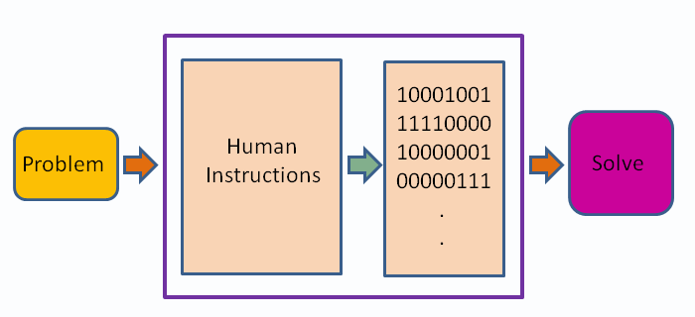
What is a programming language ?
https://en.wikiversity.org/wiki/Introduction_to_Programming/About_Programming

Slide 12
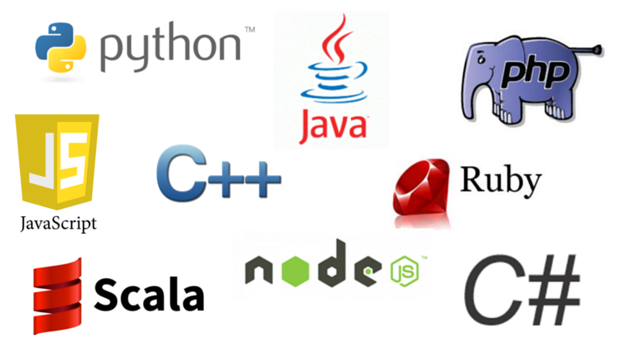
Programming language examples
https://event.fourwaves.com/spark

Slide 13
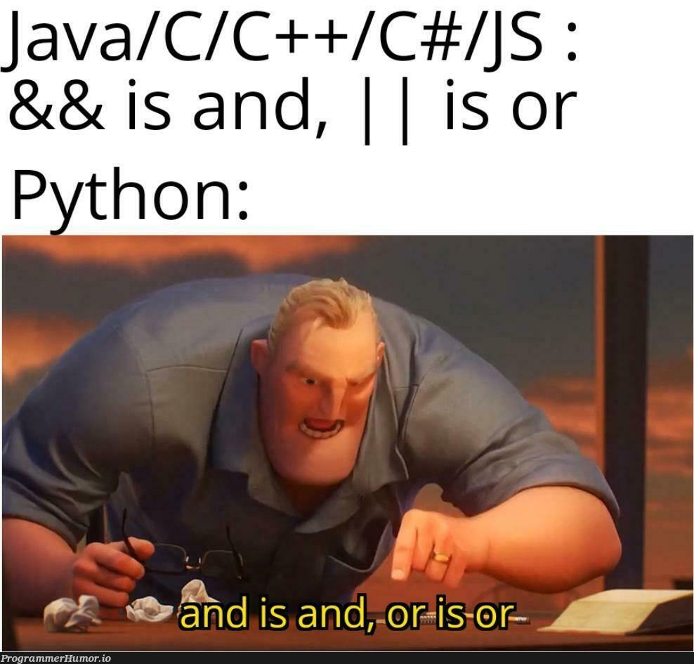
Why python
Easy to Read and Learn: Python's syntax is designed to be clear and readable, resembling plain English.
Python also has a wide variety of tools and libraries specialized on Machine learning, data science and image processing
https://programmerhumor.io/programming-memes/python-takes-literally/

Slide 14
How to learn a programming language
Syntax
Semantics
It refers to the rules and regulations for writing any statement in a programming language
It refers to the meaning associated with the statement in a programming language
https://event.fourwaves.com/spark

Slide 15
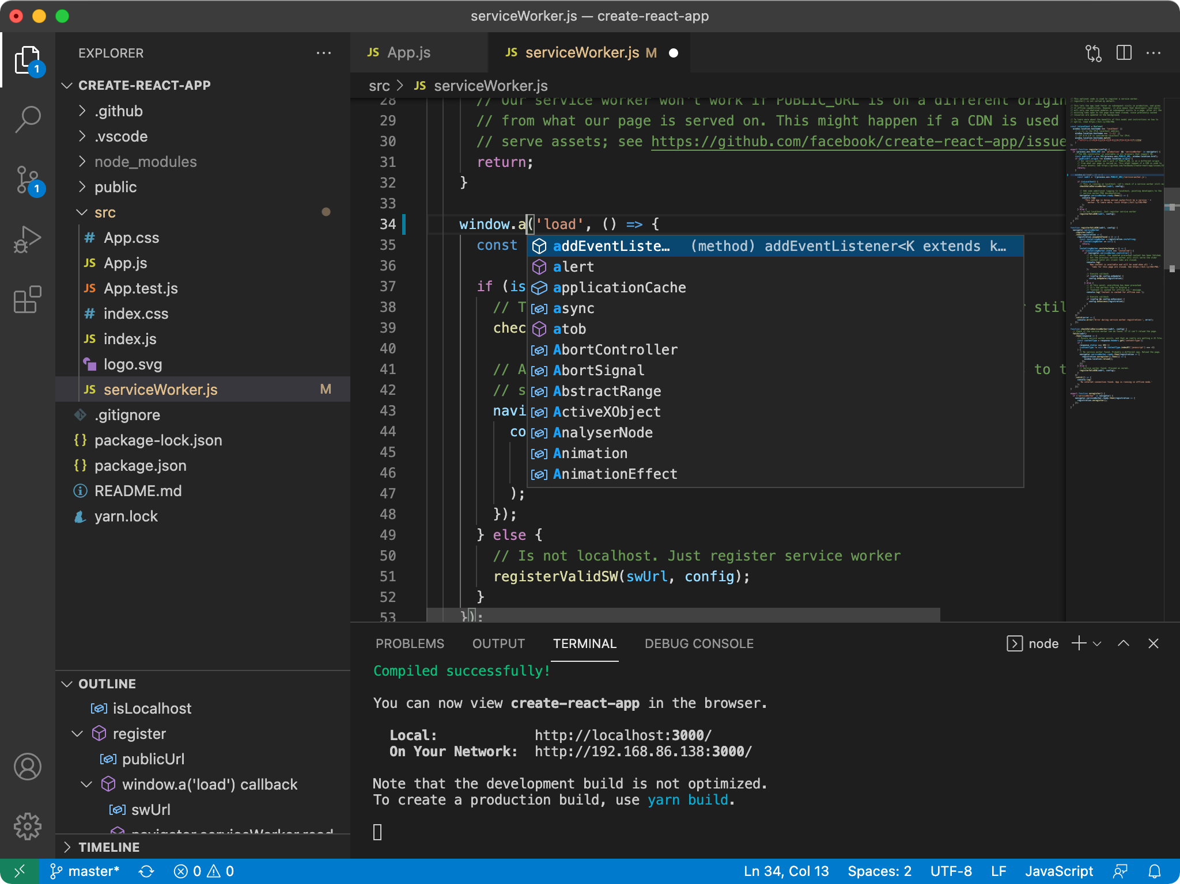

Setup for Python
VS code
A nice code editor
Create python files with the extension → .py
https://event.fourwaves.com/spark

Slide 16
Installing python
You can follow this for installation:
https://www.geeksforgeeks.org/download-and-install-python-3-latest-version/
You could use VS code terminal for that
https://event.fourwaves.com/spark

Slide 17
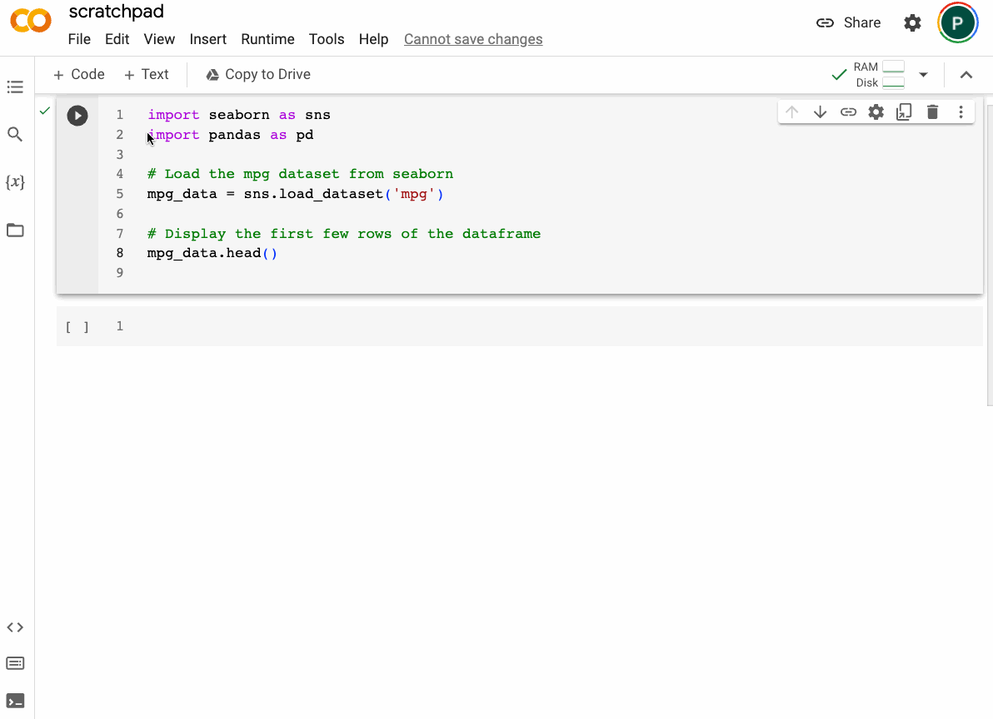
Running python in notebooks
https://towardsdatascience.com/a-close-look-at-colabs-new-updates-and-enhancements-f1225fd5d504/

Slide 18
Let’s see how to write Python
https://event.fourwaves.com/spark

Slide 19
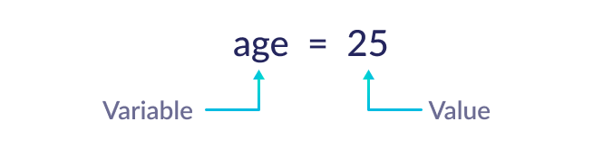
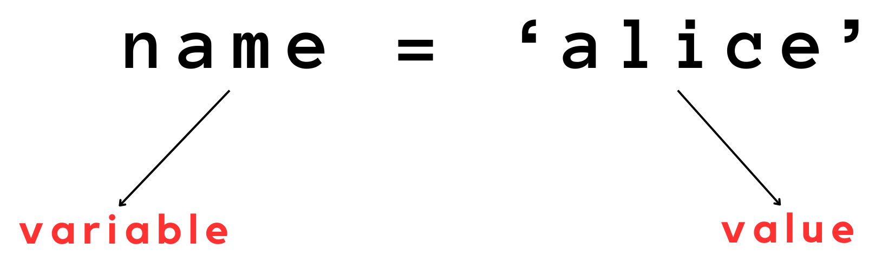
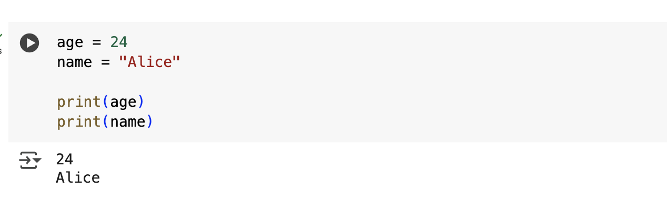
Data types and variables
Variables are containers for storing data values.
This variable is of type int “contain integer number”
This variable is of type string “contain text”
https://event.fourwaves.com/spark

Slide 20
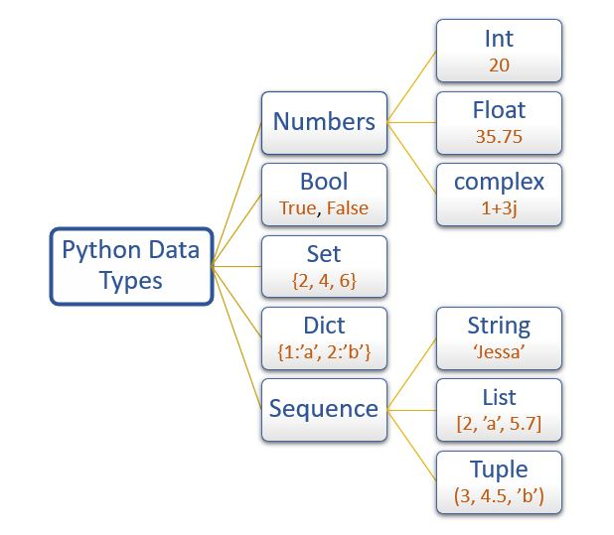
Data types and variables
https://pynative.com/python-data-types/

Slide 21
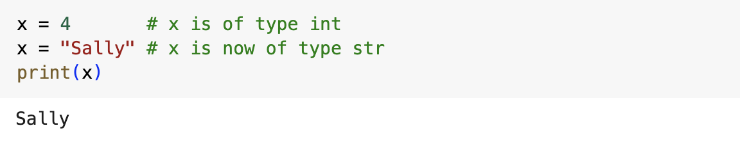
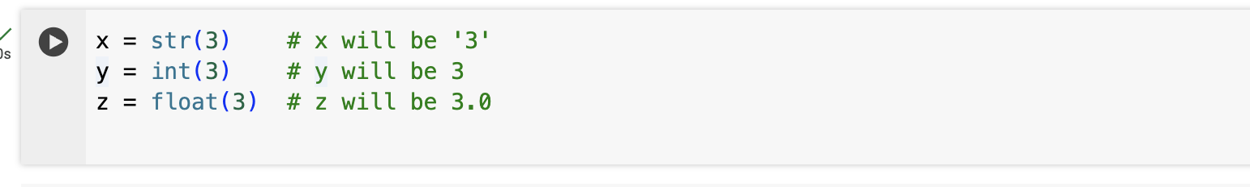
Data types and variables
https://event.fourwaves.com/spark

Slide 22
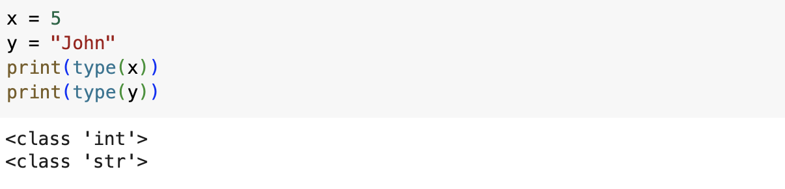
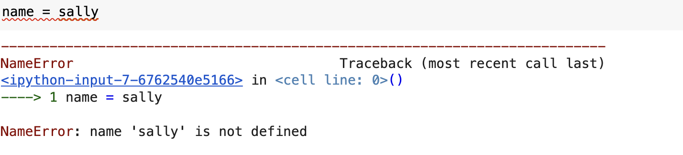
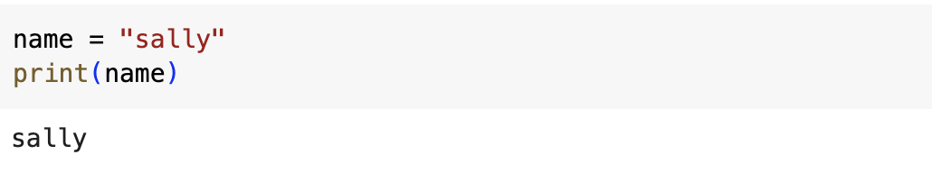
Data types and variables

Slide 23
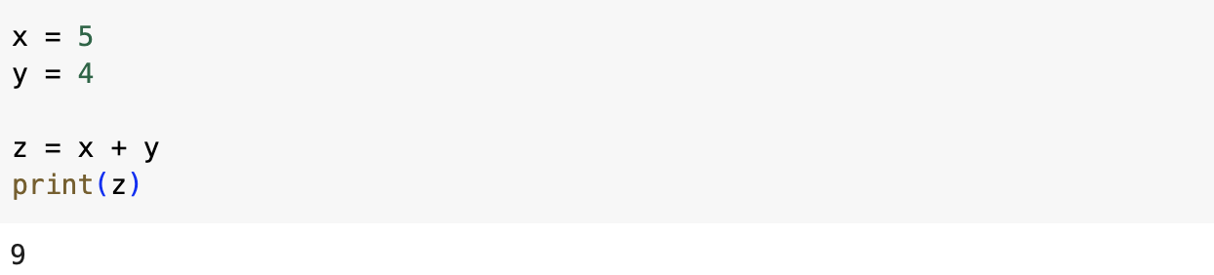
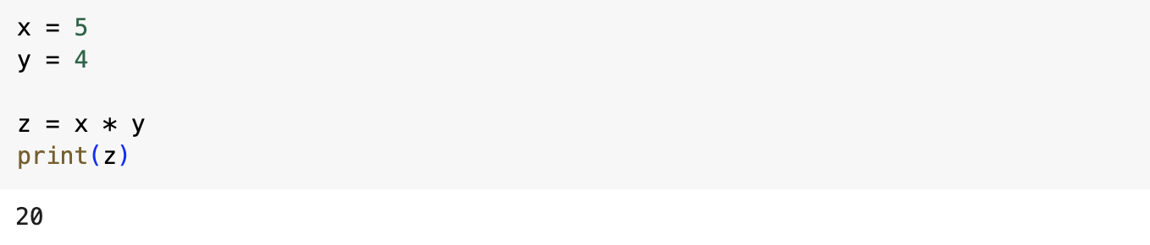
Data types and variables
https://event.fourwaves.com/spark

Slide 24
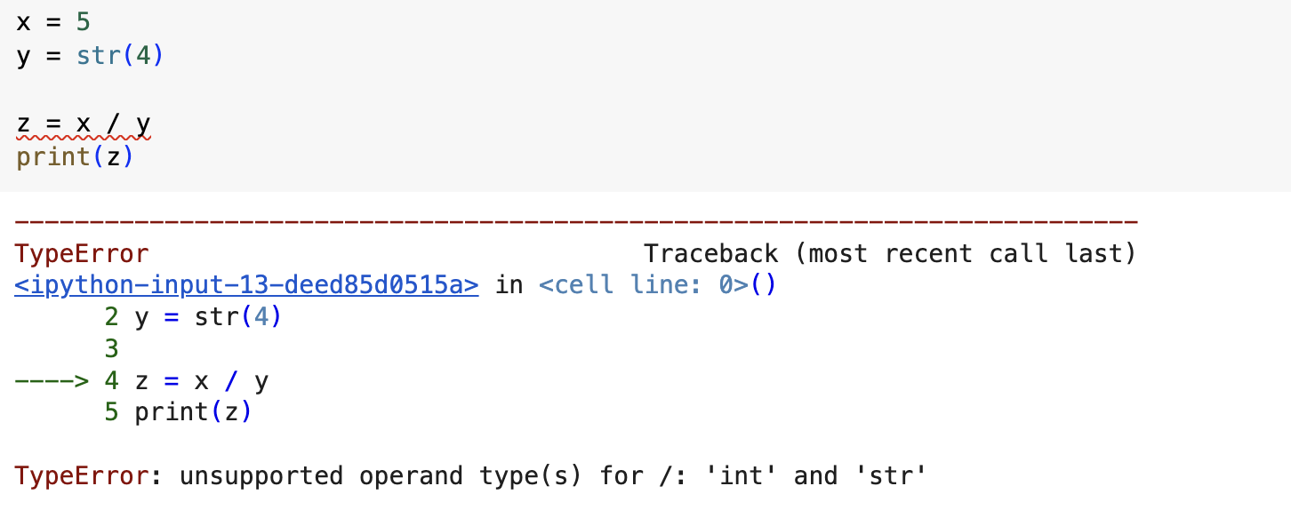
Data types and variables
https://event.fourwaves.com/spark

Slide 25
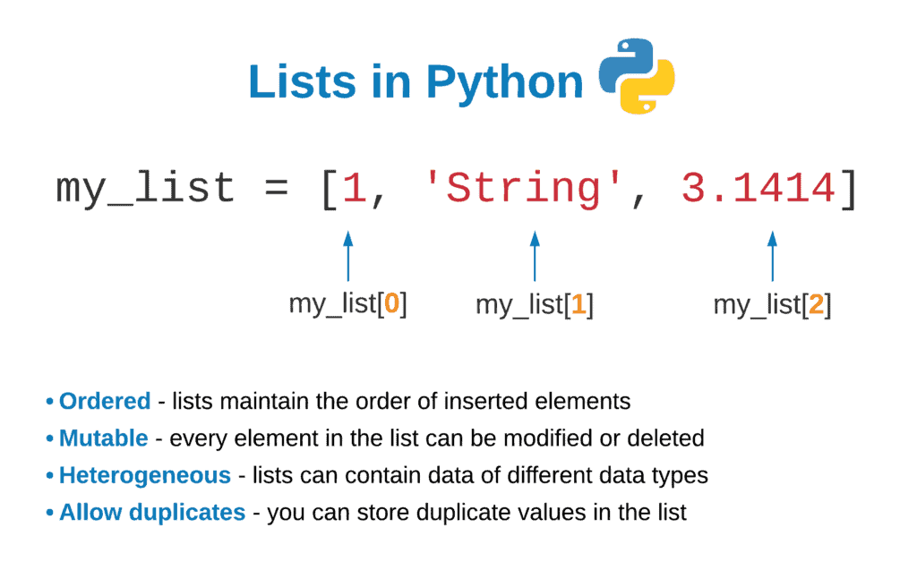
Lists in Python
https://hands-on.cloud/working-with-lists-in-python/

Slide 26
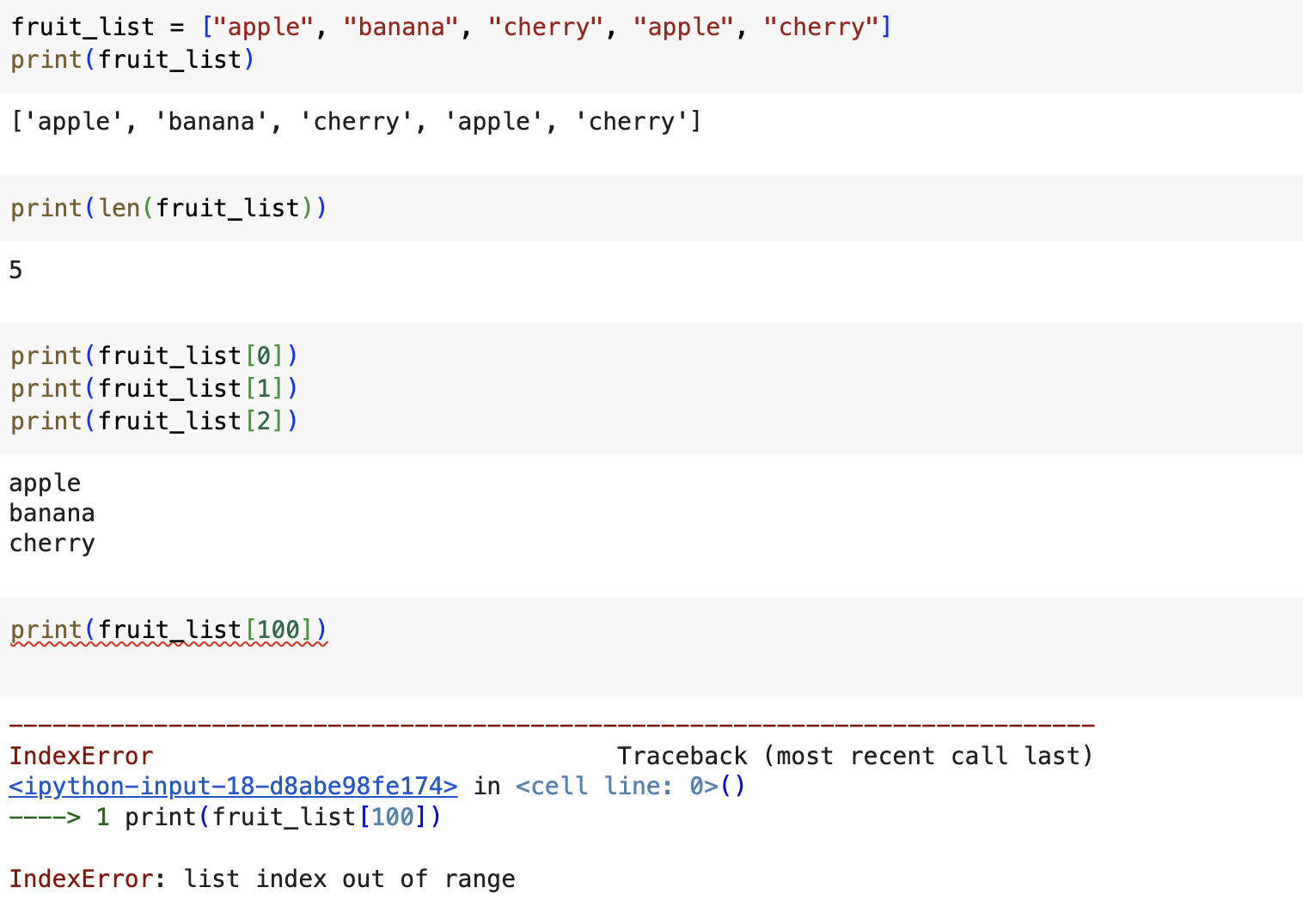
Indexing from lists in Python

Slide 27
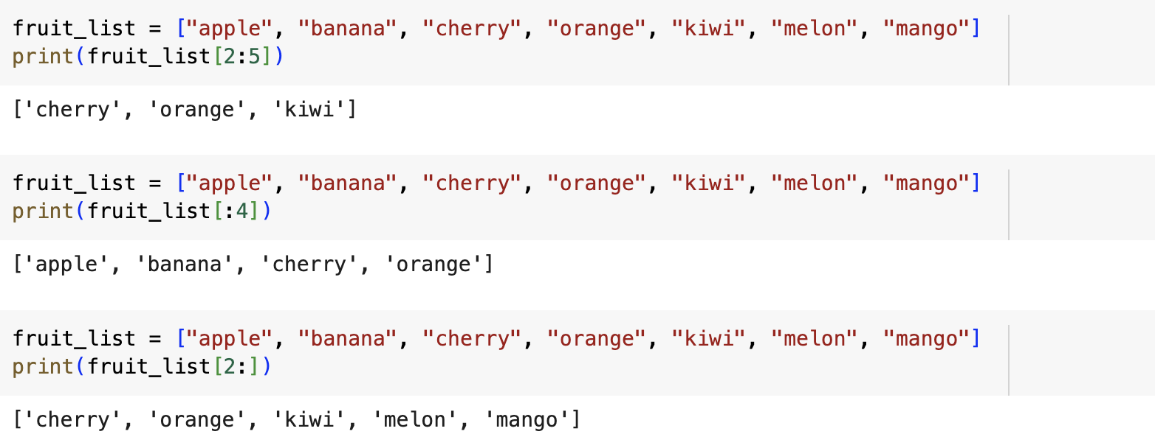
Slicing from lists in Python
https://event.fourwaves.com/spark

Slide 28
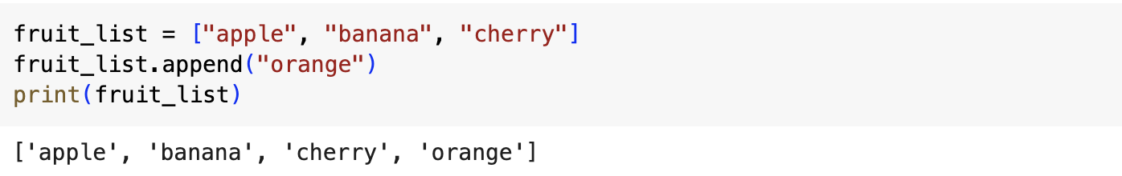
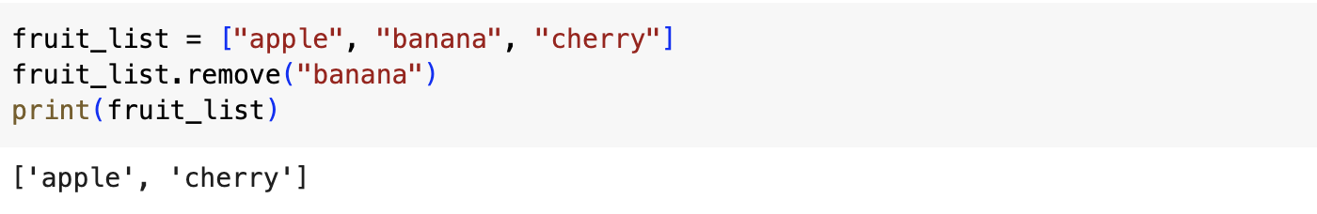
Modifying lists in Python
https://event.fourwaves.com/spark

Slide 29
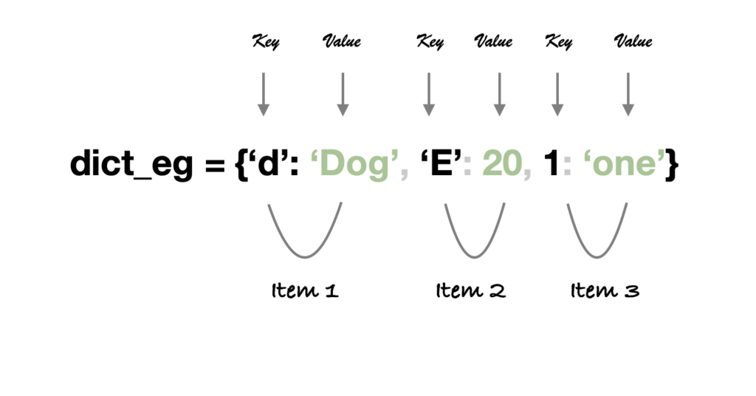
Dictionaries in python
https://www.theengineeringprojects.com/2022/03/dictionaries-in-python.html

Slide 30
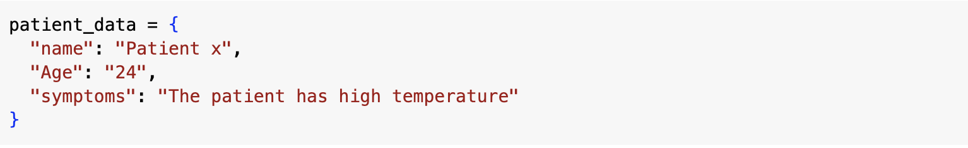
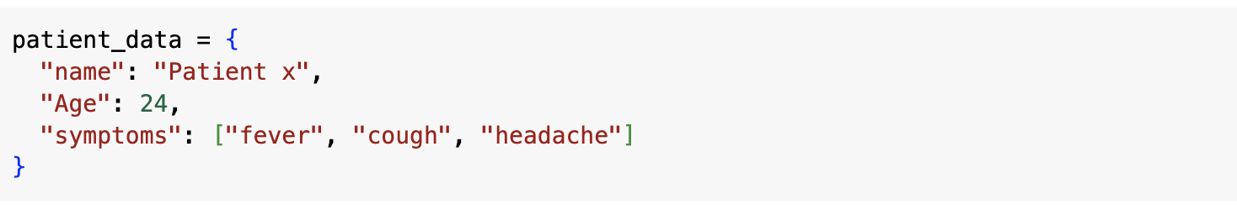
Dictionaries in python
https://event.fourwaves.com/spark

Slide 31
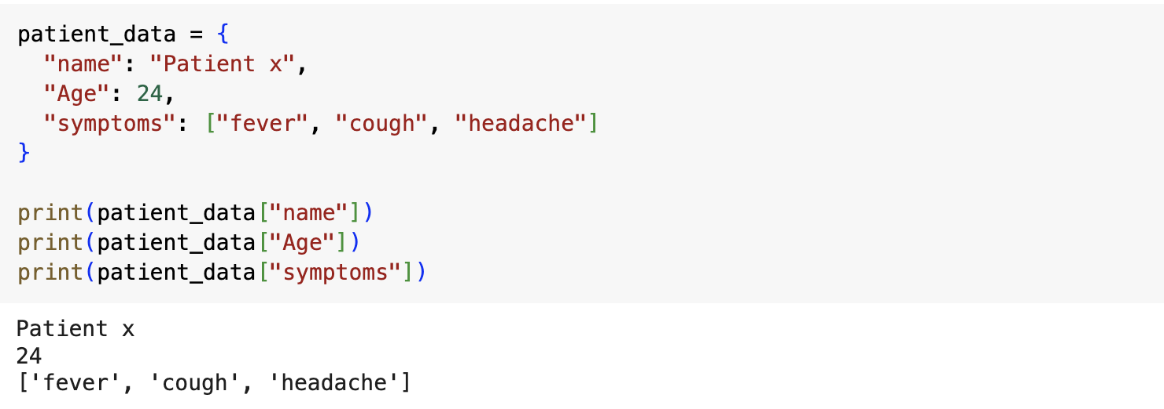
Dictionaries in python
https://event.fourwaves.com/spark

Slide 32
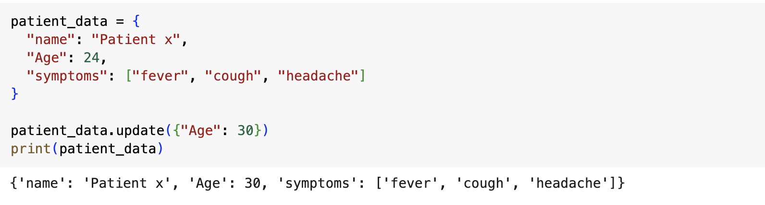
Updating dictionaries in python
https://event.fourwaves.com/spark

Slide 33
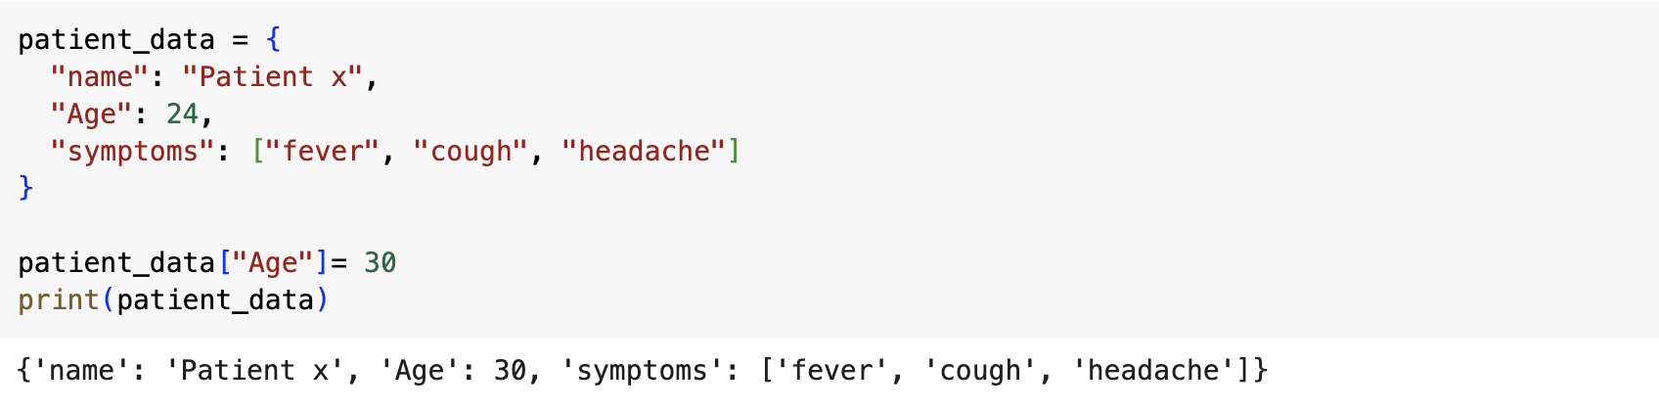
Updating dictionaries in python
https://event.fourwaves.com/spark

Slide 34
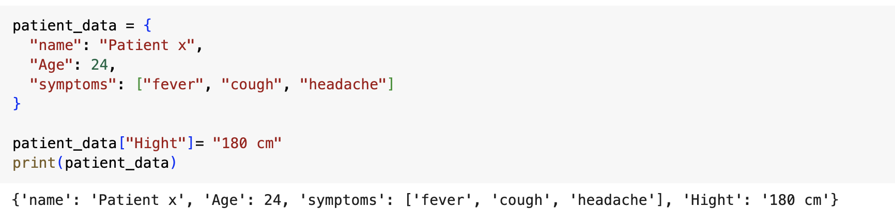
Updating dictionaries in python
https://event.fourwaves.com/spark

Slide 35
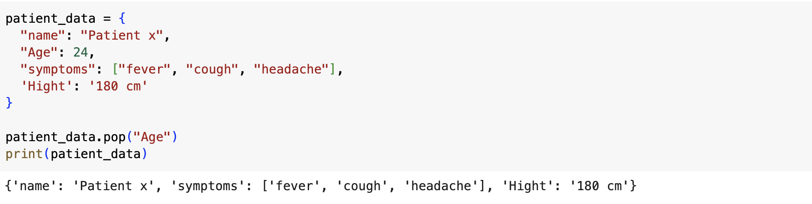
Dictionaries in python
https://event.fourwaves.com/spark

Slide 36

Now let’s have some fun and play a small game
https://event.fourwaves.com/spark

Slide 37
How many out of 13 points did you get ?!
https://event.fourwaves.com/spark

Slide 38

If you got 10 or more points, Congratulations you just became a python developer now
https://event.fourwaves.com/spark

Slide 39

How to be good at Python
Think of it as learning a new language
Practice,
Practice,
Practice
Pleeeeease Practice
Be Patient
Don't be afraid to experiment!
https://event.fourwaves.com/spark

Slide 40
Thank you .. Questions ?!
https://event.fourwaves.com/spark

